Slide 1
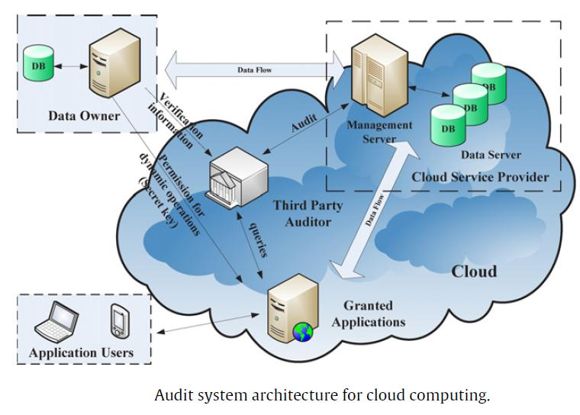
Cloud Framework

Slide 2
What is Data Center ?
A data center is a facility that centralizes an organization's IT operations and equipment, as well as where it stores, manages, and disseminates its data.
On-premise or off-premise

Slide 3
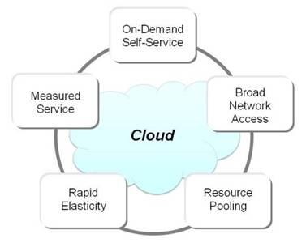
Characteristics of Cloud

Slide 4
Characteristics of Cloud
A) On demand self services:
computer services such as email, applications, network or server service can be provided without requiring human interaction with each service provider.
Cloud service providers providing on demand self services include Amazon Web Services (AWS), Microsoft, Google, IBM and Salesforce.com.
B) Broad network access:
Cloud Capabilities are available over the network and
accessed through standard mechanisms that promote use by heterogeneous thin or thick client platforms such as mobile phones, laptops and PDAs.

Slide 5
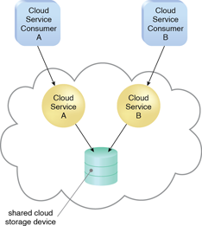
Characteristics of Cloud
C) Resource pooling:
The provider’s computing resources are pooled together to serve multiple consumers using multiple-tenant model, with different physical and virtual resources dynamically assigned and reassigned according to consumer demand.
The resources include storage, processing, memory, network bandwidth, virtual machines and email services as mobile phones, laptops and PDAs.

Slide 6
Characteristics of Cloud
D) Rapid elasticity:
Cloud services can be rapidly and elastically provisioned, in some cases automatically to quickly scale out and rapidly released to quickly scale in.
To the consumer, the capabilities available for provisioning often appear to be unlimited and can be purchased in any quantity at any time.
Rapid elasticity allows users to automatically request additional space in the cloud or other types of services. Because of the setup of cloud computing services, provisioning can be seamless for the client or user.

Slide 7
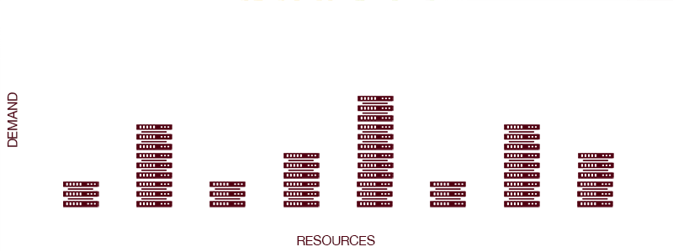
Characteristics of Cloud
Elasticity allows the cloud provider’s customers to achieve cost savings and this is often a core reason for adoption of cloud services
Example - Say that 10 servers are required for a three month project. With cloud services the company can provision them within minutes, pay a small monthly operation + execution fee to run them rather than a large upfront capital investment cost, and decommission them at the end of the three months with no further charge.

Slide 8
Contd …
E) Measured service:
Cloud computing resource usage can be measured, controlled, and reported providing transparency for both the provider and consumer of the utilized service.
Cloud computing services use a metering capability which enables to control and optimize resource use. This implies that just like air time, electricity or municipality water IT services are charged per usage metrics – pay per use. The more you utilize the higher the bill.
Cloud services generally charge users per hour of resource usage, or based on the number of certain kinds of transactions that have occurred, amount of storage in use, and the amount of data transferred over a network. All usage is measured.

Slide 9
Need for Cloud
Why are so many businesses moving to the cloud?
It’s because cloud computing increases efficiency and offers many more benefits…
Flexibility : Cloud-based services are ideal for businesses with growing or fluctuating bandwidth demands. If your needs increase it’s easy to scale up your cloud capacity, drawing on the service’s remote servers. Likewise, if you need to scale down again, the flexibility is baked into the service. This level of agility can give businesses using cloud computing a real advantage over competitors.

Slide 10
Need for Cloud
Disaster recovery :Businesses of all sizes should be investing in robust disaster recovery, but for smaller businesses that lack the required finance and expertise, this is often more an ideal than the reality. Cloud is now helping more organizations buck that trend. According to Aberdeen Group, small businesses are twice as likely as larger companies to have implemented cloud-based backup and recovery solutions that save time, avoid large up-front investment and roll up third-party expertise as part of the deal.
Automatic software updates: The beauty of cloud computing is that the servers are off-premise, out of sight and out of your hair. Suppliers take care of them for you and roll out regular software updates – including security updates – so you don’t have to worry about wasting time maintaining the system yourself. Leaving you free to focus on the things that matter, like growing your business.

Slide 11
Need for Cloud
Increased collaboration: When your teams can access, edit and share documents anytime, from anywhere, they’re able to do more together, and do it better. Cloud-based workflow and file sharing apps help them make updates in real time and gives them full visibility of their collaborations.
Work from anywhere: With cloud computing, if you’ve got an internet connection you can be at work. And with most serious cloud services offering mobile apps, you’re not restricted by which device you’ve got to hand. As a result, the businesses can offer more flexible working perks to employees so they can enjoy the work-life balance that suits them – without affecting productivity.

Slide 12
Need for Cloud
Capital-expenditure Free : Cloud computing cuts out the high cost of hardware. You simply pay as you go and enjoy a subscription-based model that’s kind to your cash flow. Add to that the ease of setup and management and suddenly your scary, hairy IT project looks a lot friendlier.
Document control :The more employees and partners collaborate on documents, the greater the need for watertight document control. Before the cloud, workers had to send files back and forth as email attachments to be worked on by one user at a time. As a result, you end up with a mess of conflicting file content, formats and titles. And as even the smallest companies become more global, the scope for complication rises. According to one study, "73% of knowledge workers collaborate with people in different time zones and regions at least monthly".
When you make the move to cloud computing, all files are stored centrally and everyone sees one version of the truth. Greater visibility means improved collaboration, which ultimately means better work and a healthier bottom line.

Slide 13
Need for Cloud
Security :Lost laptops are a billion dollar business problem. And potentially greater than the loss of an expensive piece of kit is the loss of the sensitive data inside it. Cloud computing gives you greater security when this happens. Because your data is stored in the cloud, you can access it no matter what happens to your machine. And you can even remotely wipe data from lost laptops so it doesn’t get into the wrong hands.
Competitiveness : Moving to the cloud gives access to enterprise-class technology, for everyone. It also allows smaller businesses to act faster than big, established competitors. Pay-as-you-go service and cloud business applications mean small outfits can run with the big boys, and disrupt the market, while remaining lean and nimble.

Slide 14
Need for Cloud
Environmental friendly :While the above points spell out the benefits of cloud computing for your business, moving to the cloud isn’t an entirely selfish act. The environment gets a little love too. When your cloud needs fluctuate, your server capacity scales up and down to fit. So you only use the energy you need and you don’t leave oversized carbon footprints. This is something done at Salesforce, where they try to create sustainable solutions with minimal environmental impact.

Slide 15
NIST Architecture

Slide 16
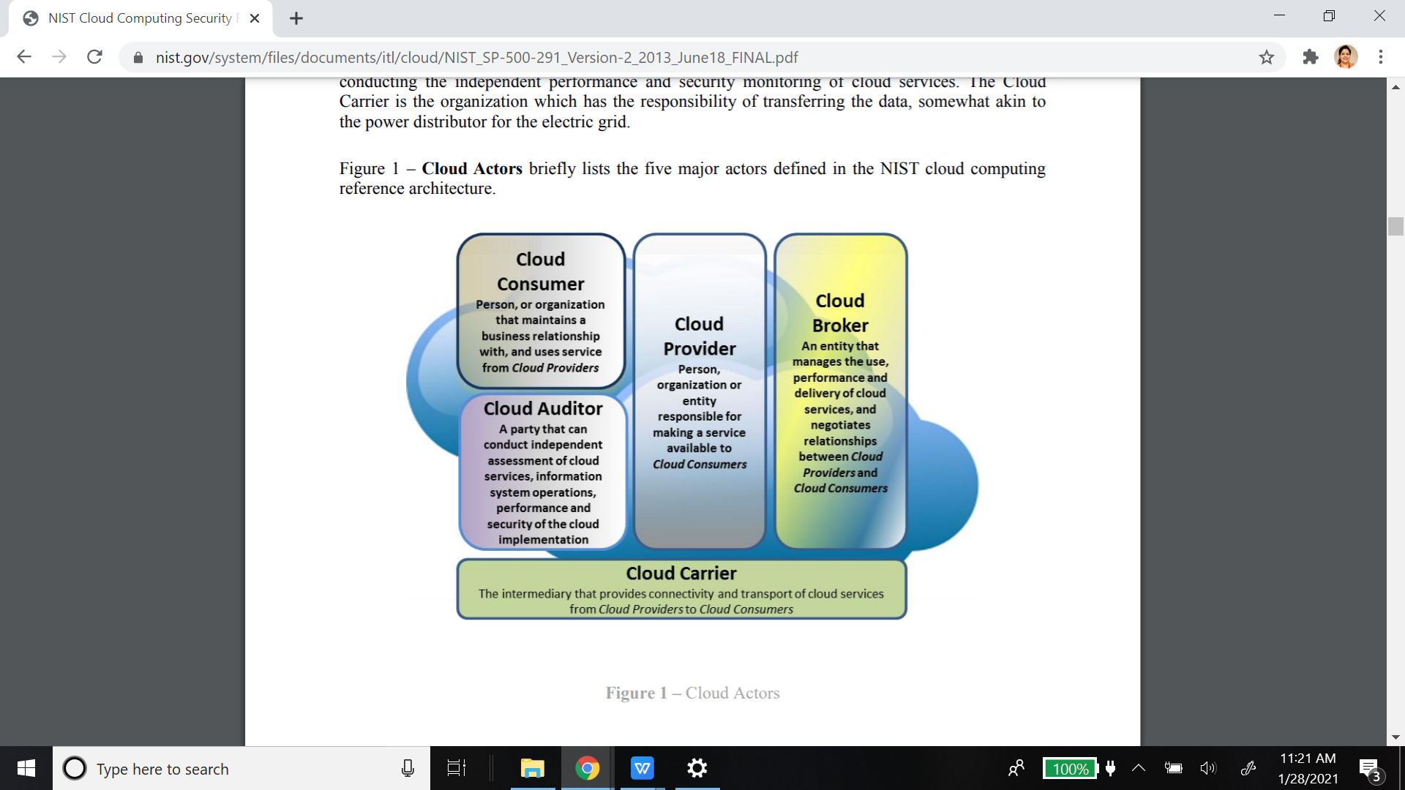
NIST - 1. Cloud Actors

Slide 17
Who are the cloud providers ?
Amazon EC2 — Virtual IT.
Google App Engine — Application hosting.
Google Apps and Microsoft Office Online — SaaS.
Apple iCloud — Network storage.
DigitalOcean — Servers (Iaas/PaaS)

Slide 18
Cloud Consumers
In 2020, top ten AWS users based on EC2 monthly spend are:
Netflix: $19 million
Twitch: $15 million
LinkedIn: $13 million
Facebook: $11 million
Turner Broadcasting: $10 million
BBC: $9 million
Baidu: $9 million
ESPN: $8 million
Adobe: $8 million
Twitter: $7 million

Slide 19
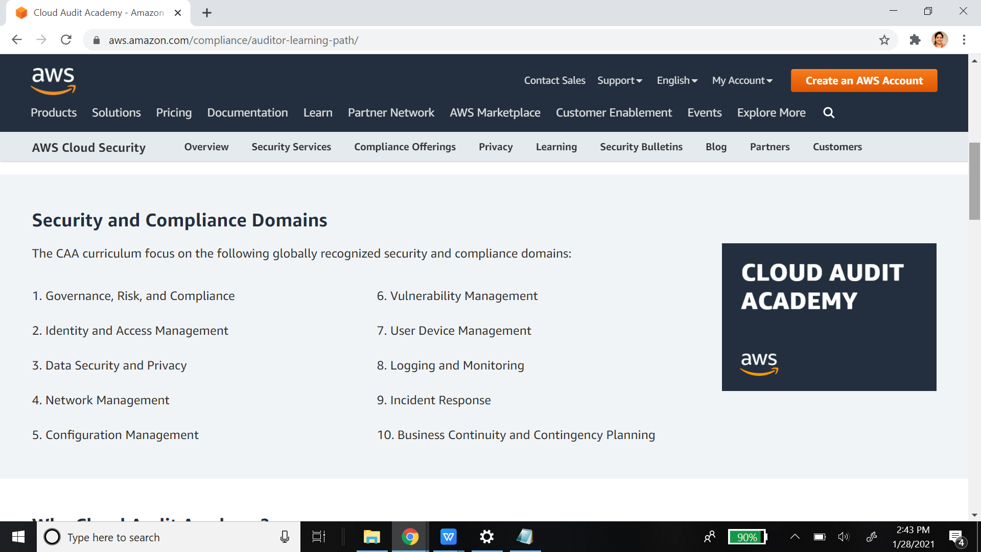
Cloud Auditing

Slide 20
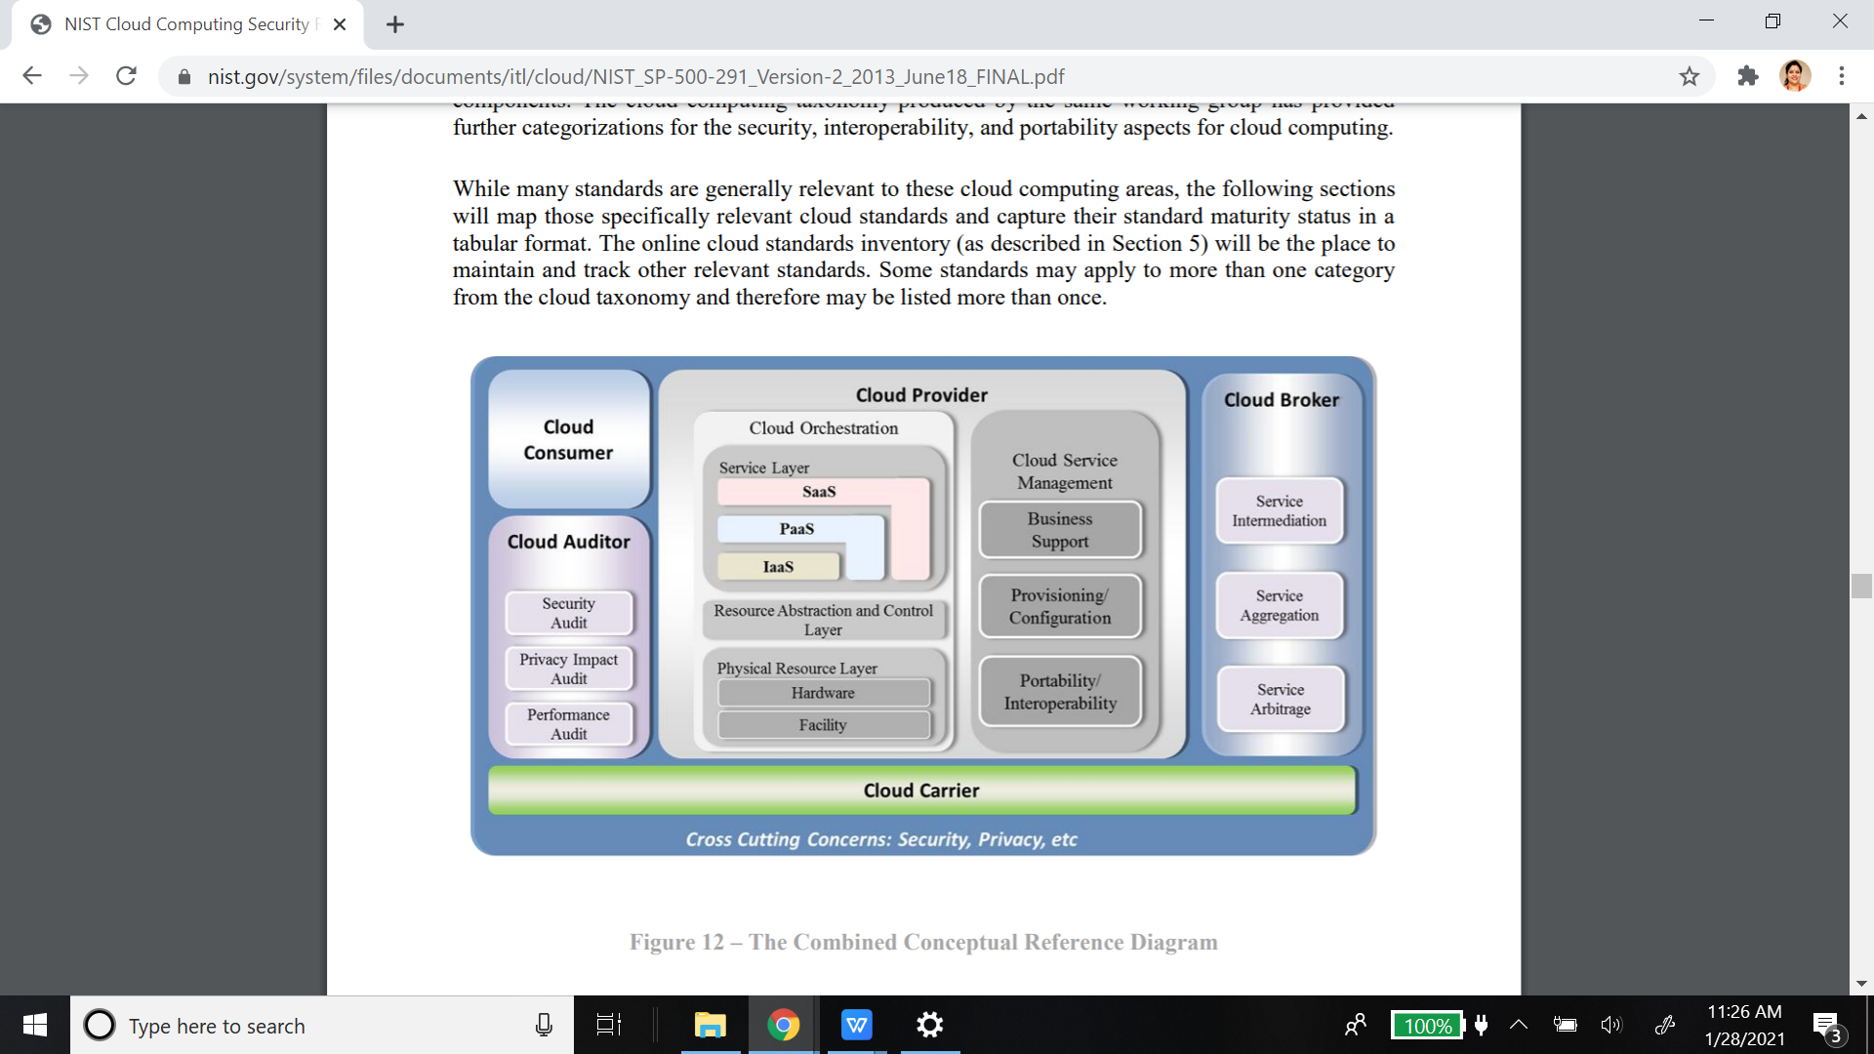
NIST :The Combined Conceptual Reference Diagram

Slide 22
Cloud deployment models
Deployment models define the type of access to the cloud.
Private cloud – It allows systems and services to be accessible within an organization. It offers higher security.
managed by the organization or a 3rd party
Located on or off premise
Ex - SBI has built own private cloud
Public cloud – It allows systems and services to be accessible by general public. It offers lesser security.
Mega scale infrastructure
Globally distributed
Ex -Amazon EC2, Gmail

Slide 23
Cloud deployment models
Community cloud - It allows systems and services to be accessible by group of organizations.
managed by organization or a 3rd party
several orgs that have shared concerns
Ex -CityCloud , A good example is the U.S.-based dedicated IBM SoftLayer cloud for federal agencies
Hybrid cloud - It is a mixture of public and private cloud. The critical activities are performed by private cloud and the non-critical activities are performed by public cloud.
Netflix, Hulu, Uber and Airbnb all rely heavily on hybrid cloud data storage due to its on-demand and pay-per-use features.

Slide 24
Public Cloud
Advantages
Public Cloud used to provide utility computing
1. COST SAVING - The most prevalent benefit in a public cloud is cost savings. Organizations do not buy, install, operate or maintain servers or other equipment as they would with private clouds. Organizations may develop their own applications, but they are hosted by a public cloud provider.
2. RELIABILITY
Since public cloud employs large number of resources from different locations, if any of the resource fail, public cloud can employ another one.
3. FLEXIBILITY
It is also very easy to integrate public cloud with private cloud, hence gives consumers a flexible approach.
4.LOCATION INDEPENDENCE
Since, public cloud services are delivered through Internet therefore ensures location independence.
5. UTILITY STYLE COSTING
Public cloud is also based on pay-per-use model and resources are accessible whenever consumer needs it. It helps businesses, especially the small and medium size, to tightly control their costs by paying for the infrastructure only based on their needs

Slide 26
Public cloud contd..
6. HIGH SCALABILITY
Cloud resources are made available on demand from a pool of resources, i.e., they can be scaled up or down according the requirement.
7. No Maintenance:
The cloud provider is responsible for the maintenance of the hardware, software, and networks in the cloud. Businesses, therefore, do not need to worry about keeping their infrastructure up-to-date or worry about aspects like security and upgrades
Disadvantages
1. Lacks proper controls: The client has no control of data or infrastructure. There are issues of data privacy and integrity. The service level policies and compliances are completely enforced by the service provider.
2. Weak on Security: Since the hardware resource is shared between multiple users, IT security issues are more profound and data is vulnerable to thefts.
3. Performance: The performance of the network depends on the speed of the internet connectivity.
Example
–Amazon EC2: Amazon datacenters, Xen, EC2 APIs and administrative interface
–Google AppEngine: Google data center, GFS, AppEngine APIs, administrative interface…
–Batch processing softwares: MapReduce, Hadoop, Pig, Dryad

Slide 27
Private Cloud - Advantages
The private cloud allows systems and services to be accessible within an organization. It is more secured because of its private nature. Datacenter are not available for rental.
1.) HIGHER SECURITY AND PRIVACY
Private cloud operations are not available to general public and resources are shared from distinct pool of resources, therefore, ensures high security and privacy. This restricted access of private cloud can integrate with a firm's firewall and other remote access policies, offers an additional layer of security.
2) Improved reliability: When compared to either dedicated hardware or public cloud alternatives, private cloud offers a greater degree of reliability thanks to a fault resilient and redundant architecture that isn't shared in any way.
3) Increased flexibility: Unlike a physical machine, a virtual machine can be scaled up and down seamlessly. And when you own all the virtual machines, you can reallocate resources dynamically, wherever they are needed most.
4) Total CONTROL
Private clouds have more control on its resources and hardware than public cloud because it is accessed only within an organization. Although there is a fair amount of universal best practice that you should no doubt follow, you are free to build and configure your private cloud in any way you like. For example, you have the freedom to use any operating systems and applications you please and to allocate resources in any way you see fit
5) Better performance - A private cloud stays inside company's intranet network behind a firewall. It provides access to the same resources as the public model, but with less exposure to Internet security risks.

Slide 28
Private cloud contd..
Disadvantages
1. RESTRICTED AREA
Private cloud is only accessible locally and is very difficult to deploy globally.
2. INFLEXIBLE PRICING & Higher Cost
In order to fulfill demand, purchasing new hardware is very costly. private clouds are more expensive than public because they require both hardware and maintenance. You will need not only the hardware but also the operating system and licenses for software applications.
3. LIMITED SCALABILITY
Private cloud can be scaled only within capacity of internal hosted resources.
4. ADDITIONAL SKILLS
In order to maintain cloud deployment, organization requires more skilled and expertise.
5. Under-utilisation: With a private cloud, the cost of capacity under-utilisation is a cost to you, not to your provider. Therefore managing and maximising utilisation becomes your concern.
6. Maintenance - Set up and support for private cloud is more expensive and time consuming than deploying on a public cloud service. It's an investment that needs continuous support and maintenance. A private cloud service requires in-house IT administration.
Example - SBI
Oracle Cloud Platform, Cisco ONE Enterprise Cloud Suite,HP Data Centers

Slide 29
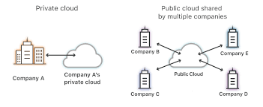
Private and Public cloud

Slide 30
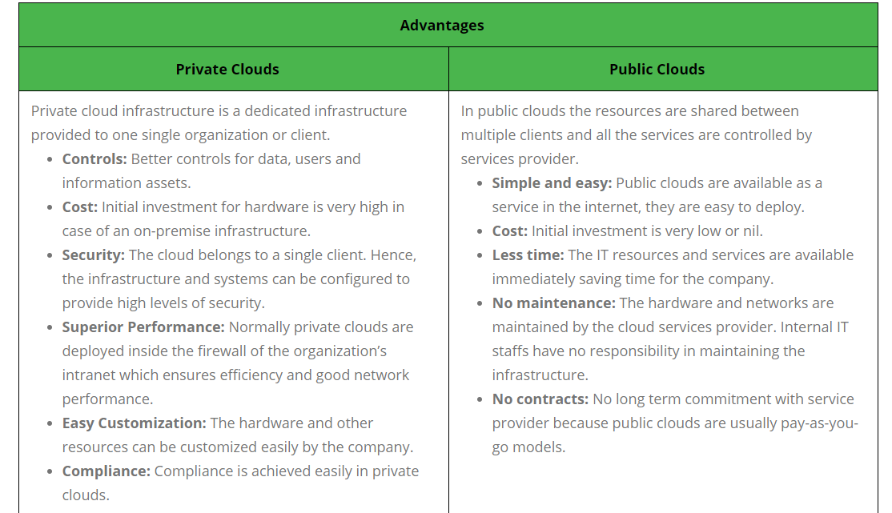
Private vs Public Cloud

Slide 31
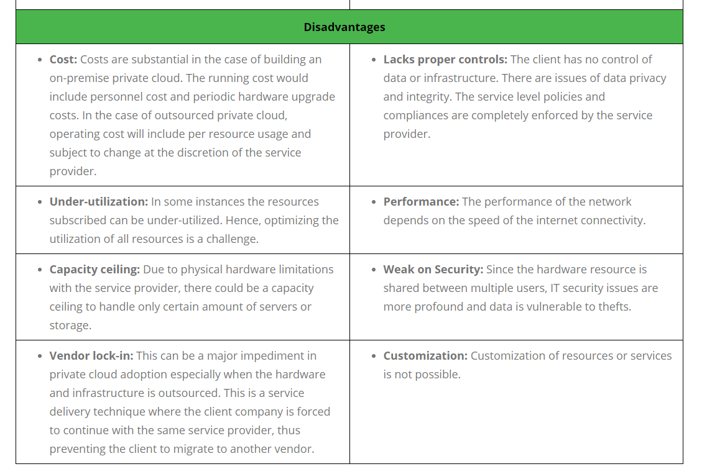
Private vs Public Cloud

Slide 32
Hybrid Cloud
Advantages
1. SCALABILITY
It offers both features of public cloud scalability and private cloud scalability.
2. FLEXIBILITY
It offers both secure resources and scalable public resources.
3. COST EFFICIENCIES
Public cloud are more cost effective than private, therefore hybrid cloud can have this saving.
4. SECURITY
Private cloud in hybrid cloud ensures higher degree of security.
Protecting valuable data is always a challenge in any networked enabled applications.
5. Control - Rather than entrusting all aspects of IT infrastructure to a third-party cloud provider, companies can customize the private end of their hybrid cloud model to their specific needs and adjust them accordingly as they see fit.
6. Speed – Though this model is not as much as faster than public cloud but still it is better than private one.

Slide 33
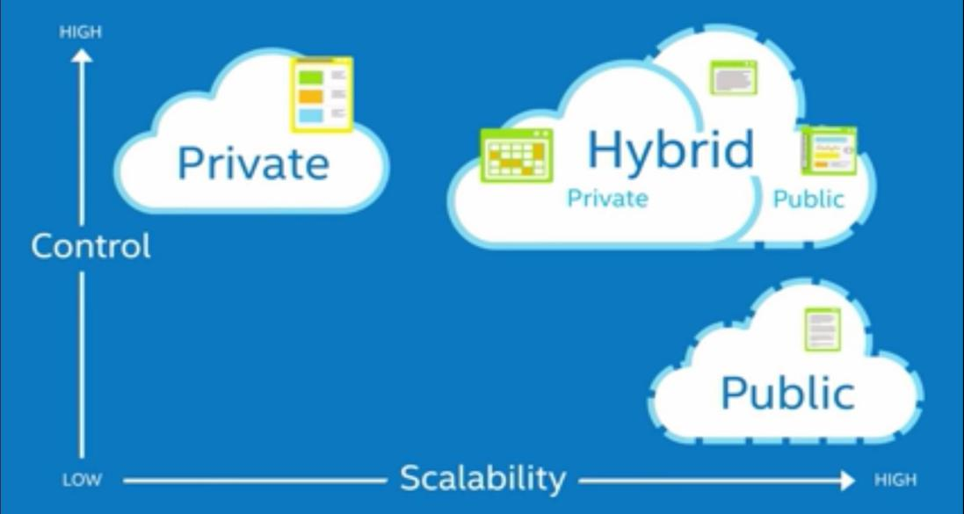
Hybrid Cloud contd..
With a hybrid cloud model, however, companies can leverage the security of a private cloud with the power and services of a public cloud.
While data stored in a private environment will likely still have to be transmitted to the public cloud for analytics, applications, and other processes, extensive encryption methods can be implemented to ensure this data remains as secure as possible.

Slide 34
Hybrid Cloud
Disdvantages
NETWORKING ISSUES (complex system architecture)
Networking becomes complex due to presence of private and public cloud.
SECURITY COMPLIANCE
It is necessary to ensure that cloud services are compliant with organization's security policies.
COST - While the public cloud can offer an attractive option for its flexibility and relatively low cost to operate, building a private enterprise cloud requires significant expenditure and can become expensive very quickly with all the physical hardware necessary.
COMPATIBILITY - Compatibility across infrastructure can prove itself to be a major issue when building a hybrid cloud. With dual levels of infrastructure, a private cloud the company controls and a public one that it doesn’t, the chances are that they will be running different stacks.

Slide 35
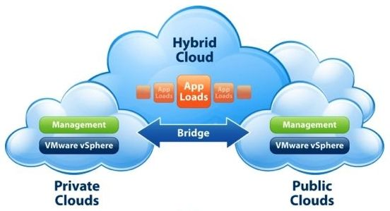
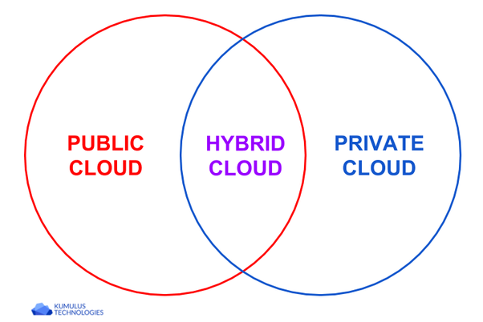
Hybrid Cloud
Top 5 Hybrid Cloud Providers:
Amazon
Microsoft
Google
Cisco
NetApp

Slide 36
Community cloud
The community cloud allows systems and services to be accessible by a group of organizations.
It a cloud service model that provides a cloud computing solution to a limited number of individuals or organizations that is governed, managed and secured commonly by all the participating organizations or a third party managed service provider
It shares the infrastructure between several organizations from a specific community.
A multi-tenant setup developed using cloud among different organizations that belong to a particular community or group having similar computing concern.

Slide 37
Community cloud
Advantages
COST EFFECTIVE
Community cloud offers same advantage as that of private cloud at low cost.
Flexibility & Scalability –
The community cloud is very scalable and flexible as it is mostly compatible with every user and they can modify as per their use.
Availability & Reliability –
The replication of data is done in the cloud to protect it against the disaster. It is replicated to various places which are safe and secure. The cloud replicates your system, applications, and data to an alternate facility
SECURITY & COMPLIANCE
Community cloud is comparatively more secure than the public cloud.

Slide 38
Community cloud
Disadvantages
Since all data is housed at one location, one must be careful in storing data in community cloud because it might be accessible by others.
It is also challenging to allocate responsibilities of governance, security and cost.
Costly than public cloud
Ex –
Gov Cloud by Google
Nebula by NASA

Slide 39
SERVICE MODELS

Slide 40
Cloud Service Models
Cloud computing is based on service models. These are categorized into three basic service models which are –
Infrastructure-as–a-Service IaaS
Platform-as-a-Service PaaS
Software-as-a-Service SaaS
Anything-as-a-Service XaaS is yet another service model, which includes Network-as-a-Service, Business-as-a-Service, Identity-as-a-Service, Database-as-a-Service or Strategy-as-a-Service.
The Infrastructure-as-a-Service IaaS is the most basic level of service. Each of the service models inherit the security and management mechanism from the underlying model, as shown in the following diagram:

Slide 41
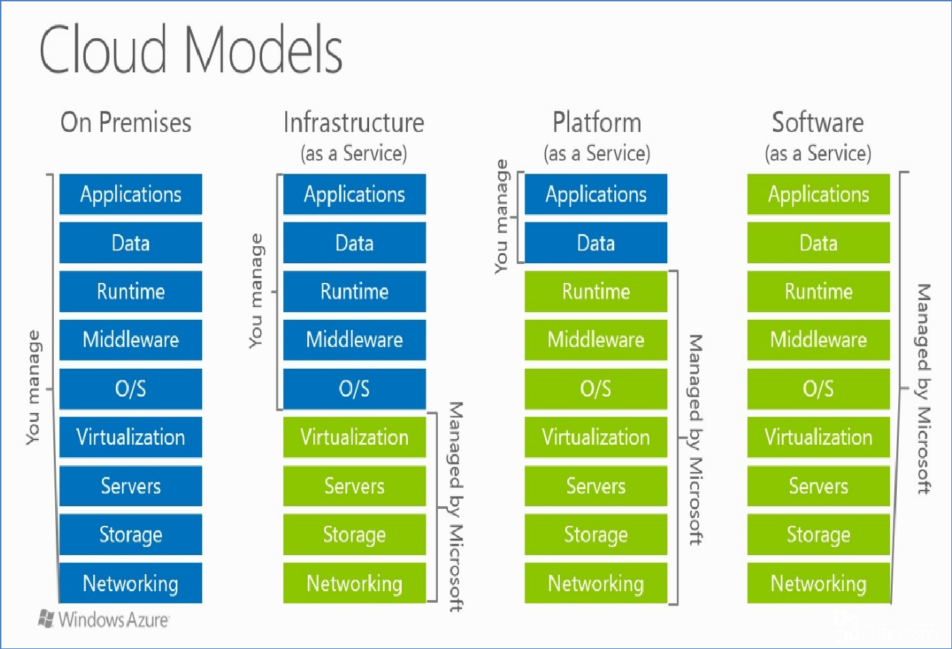








Slide 42
Infrastructure-as-a-Service IaaS

Slide 43
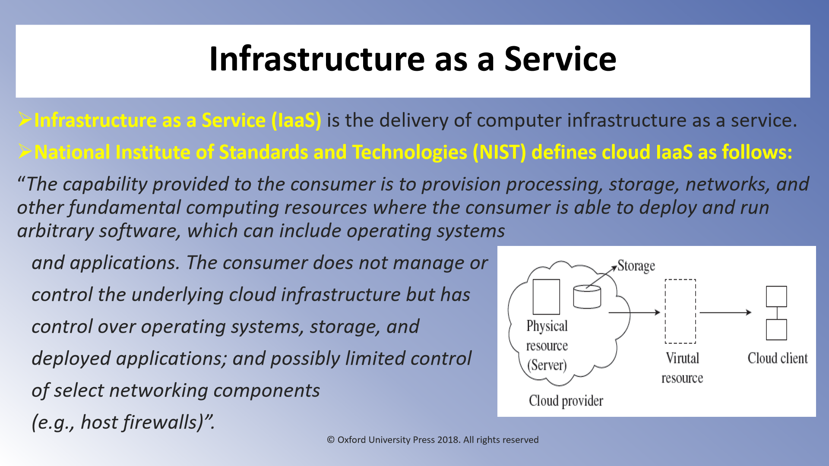

Slide 44
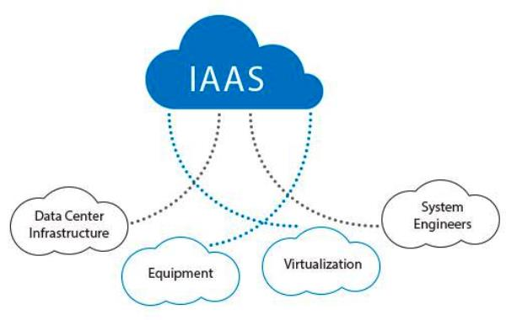
Infrastructure-as-a-Service IaaS
IaaS provides access to thefollowing fundamental resources such as:
physical machines,
virtual machines,
virtual storage,
rent processing, storage,
N/W capacity and computing resources,
Firewall, load balance, etc.
Load Balancer
IP Adresses
Software Bundels
Data Center Space
Network Component
This model delivers computer infrastructure on an outsourced basis to support enterprise operations
All of the above resources are made available to end user via server virtualization.
Moreover, these resources are accessed by the customers as if they own them.

Slide 45
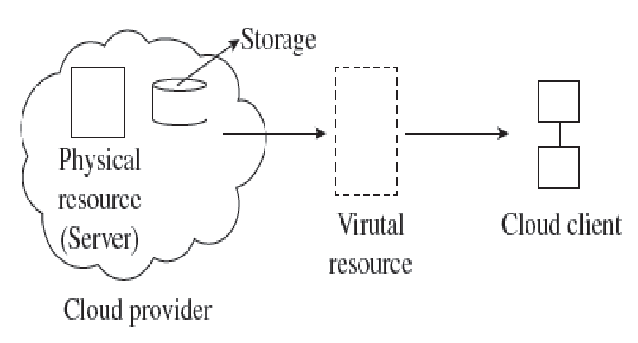
IaaS Examples
Popular examples of IaaS include
DigitalOcean,
Linode,
Rackspace,
Amazon Web Services (AWS),
Cisco Metacloud,
Microsoft Azure, and
Google Compute Engine (GCE)

Slide 46
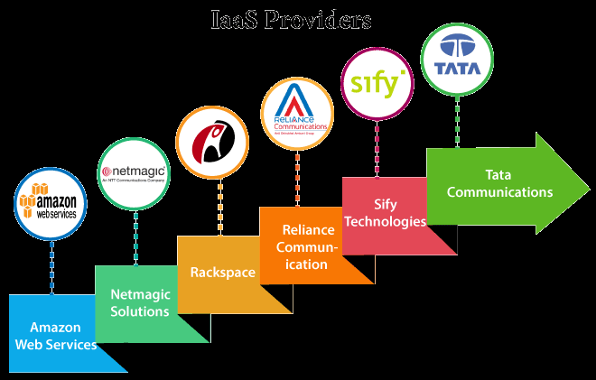

Slide 47


































































Slide 48
IaaS Benefits
IaaS allows the cloud provider to freely locate the infrastructure over the Internet in a cost-effective manner.
Some of the key benefits of IaaS are listed below:
Full Control of the computing resources through Administrative Access to VMs. --
IaaS allows the consumer to access computing resources through administrative access to virtual machines in the following manner:
Consumer issues administrative command to cloud provider to run the virtual machine or to save data on cloud's server.
Consumer issues administrative command to virtual machines they owned to start web server or installing new applications.

Slide 49



IaaS Benefits
2. Flexible and Efficient renting of Computer Hardware.
IaaS resources such as virtual machines, storages, bandwidth, IP addresses, monitoring services, firewalls, etc.,
all are made available to the consumers on rent.
The consumer has to pay based the length of time a consumer retains a resource. Also with administrative access to virtual machines, the consumer can also run any software, even a custom operating system.
3. Portability, Interoperability with Legacy Applications.
It is possible to maintain legacy between applications and workloads between IaaS clouds.
For example, network applications such as web server, e-mail server that normally runs on consumer-owned server hardware can also be run from VMs in IaaS cloud.

Slide 50













IaaS Benefits
4. Cost Saving & On Demand Scalability
5. No need to set up, maintain or update the hardware
6. IaaS has greater reliability with the service provider. If any particular hardware components fail, or even internet connection fails or entire data go offline, an organization’s infrastructure would not be affected

Slide 51
Iaas Issues
1. Changing the provider is very much complicated
2. Possible privacy issues due to the provider's server locations
3. Security
The enterprise does not have any control over cloud security in an IaaS environment.
They need to review the Cloud Service provider’s service level agreement (SLA) to help them understand its security obligations and thereby identifying gaps in their security coverage
4. Lack of flexibility
Service providers maintain the software, but they do not upgrade the software for some of the businesses
5. Technical problems
Organizations faces some downtime with IaaS, and it will restrict their access to applications and data
6. Over Dependency
Having IaaS in your organization means have a full dependency on the provider or third party for your data
7. Upgrade & Maintenance
The organization is solely responsible for any upgrades of software and maintenance of tools or data system.

Slide 52
Platform-as-a-Service PaaS

Slide 53
PaaS
PaaS provides the runtime environment for applications, development and deployment tools, etc. Platform as a service (PaaS) is a cloud computing model in which a third-party provider delivers hardware and software tools -- usually those needed for application development -- to users over the internet
PaaS has a feature of point-and-click tools that enables non-developers to create web applications.
EXAMPLES -
Google's App Engine, Force.com Microsoft Azure, AWS, Aneka, salesforce.com, IBM Google, Ali Baba are examples of PaaS offering vendors. AWS Elastic Beanstalk, Heroku, Apache Stratos.
Developer may log on to these websites and use the built-in API to create web-based applications.

Slide 54
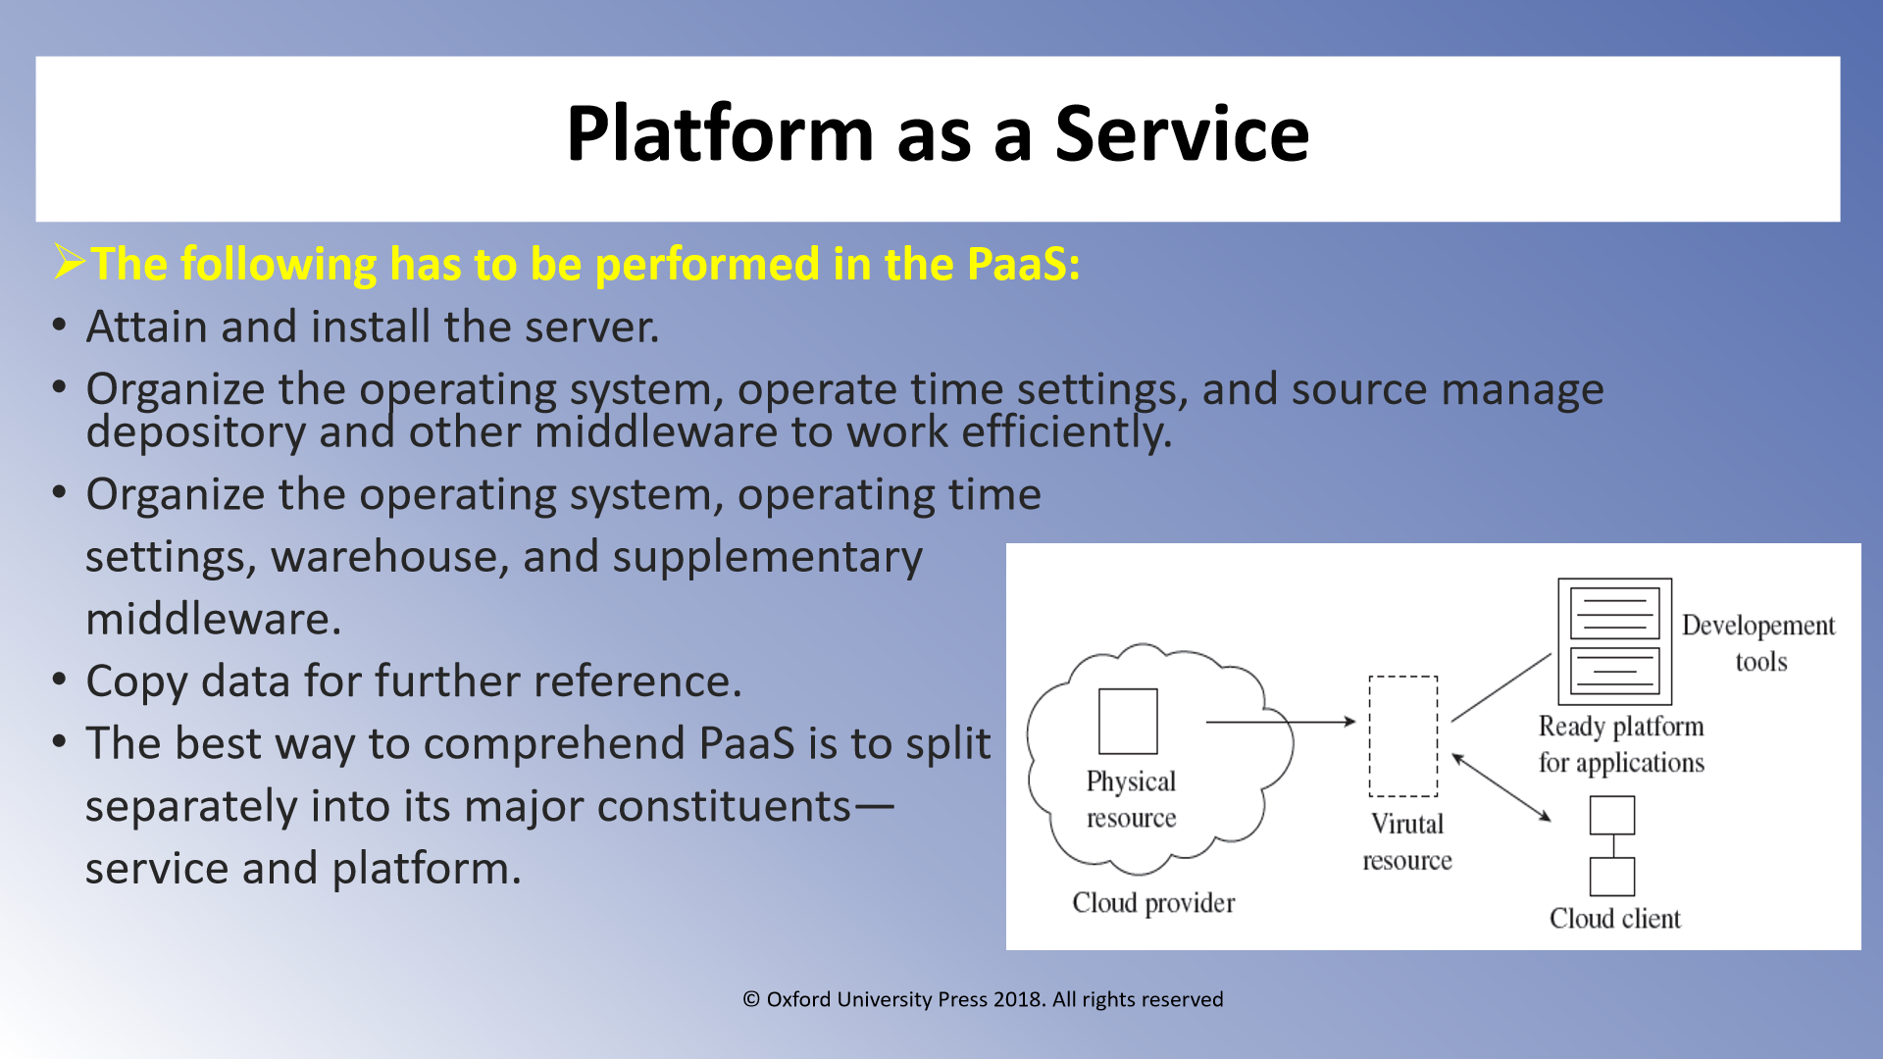

Slide 55
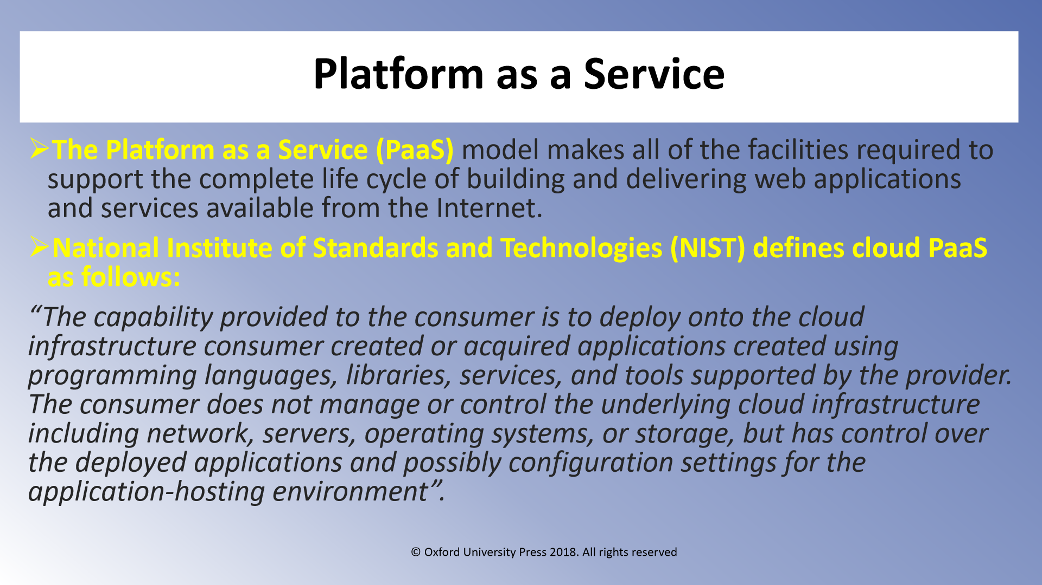

Slide 56
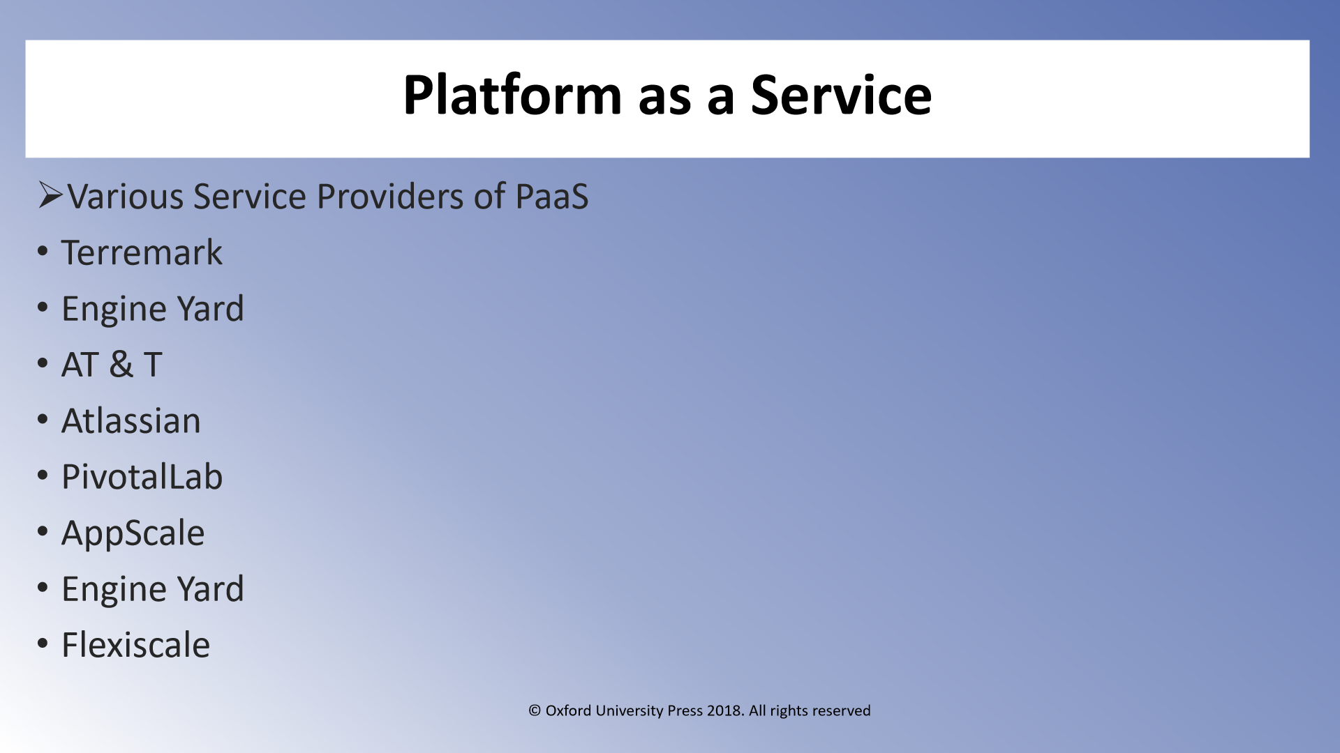

Slide 57
PaaS - Benefits
AutomatedUpdates:
software updates are automatically done and you get access to all the latest versions, updates etc.
There is no risk of missing out on an update. This can save you plenty of resources and time. Security patches take care of any bugs and other securityissues.
LowInvestments:
You can use the software without having to make any investment in infrastructure that otherwise they procure in an in-house environment.
ReducedCosts:
Since the payment model is pay-as-you-use, there is considerable savings for you without having to install the necessary software like databases, server etc to run theapplications.
Collaboration:
Since it is an internet-based platform, it enables the employees to login and work on the applications from anywhere, make their updates without physically being present in the business premises.
Focus:
Your IT team can focus better on core applications rather than being diverted on maintenance of the system.

Slide 58
PaaS disadvantages
Vendor lock-in:
This is one possibility you must check thoroughly before signing up with a provider. If you get locked in a specific language, program, or interface that could affect you with some unnecessary system that you do not require.
Dependency on Vendor
On the one hand, it’s a great advantage that a certain part of work is done by the provider without you having to make an effort.
On the other hand, your business will still be governed by the provider’s functional capabilities, speed and reliability.
That’s why it’s very important to be confident in your business partner and be prepared for some unforeseen circumstances that may happen to even the most reliable provider.
At the very least, you should perform your own data backup, for your peace of mind.
Compatibility of Existing Infrastructure
A new platform is a new environment where legacy solutions are supposed to continue to work. Undoubtedly, some difficulties and contradictions may arise when two systems come into contact. Thus, it’s crucial to understand possible compatibility problems beforehand and to prepare to solve them.
Security Risks
As a rule, PaaS software is available in a public environment where multiple end users have access to the same basic resources.

Slide 59
Software-as-a-Service SaaS

Slide 60
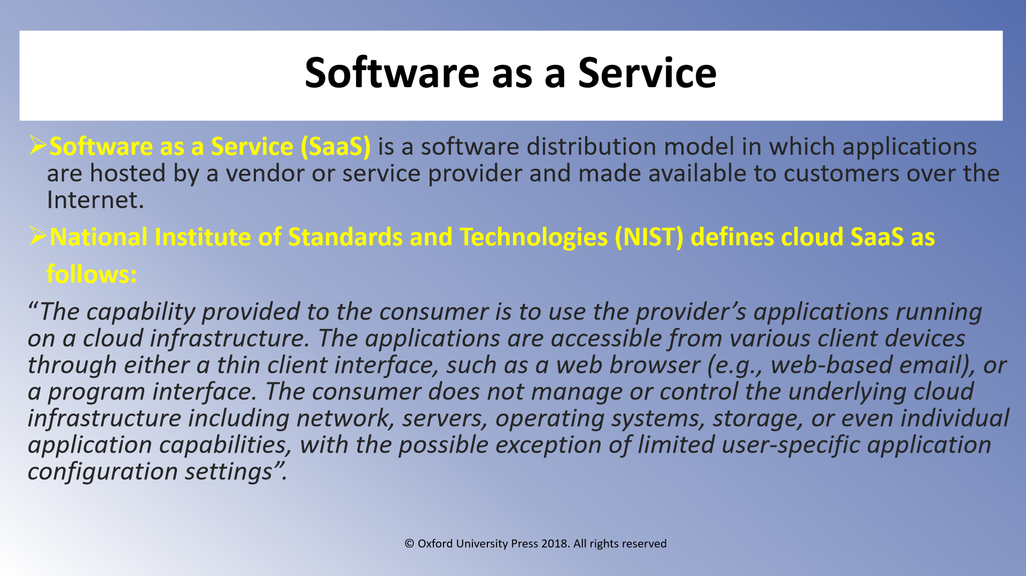

Slide 61
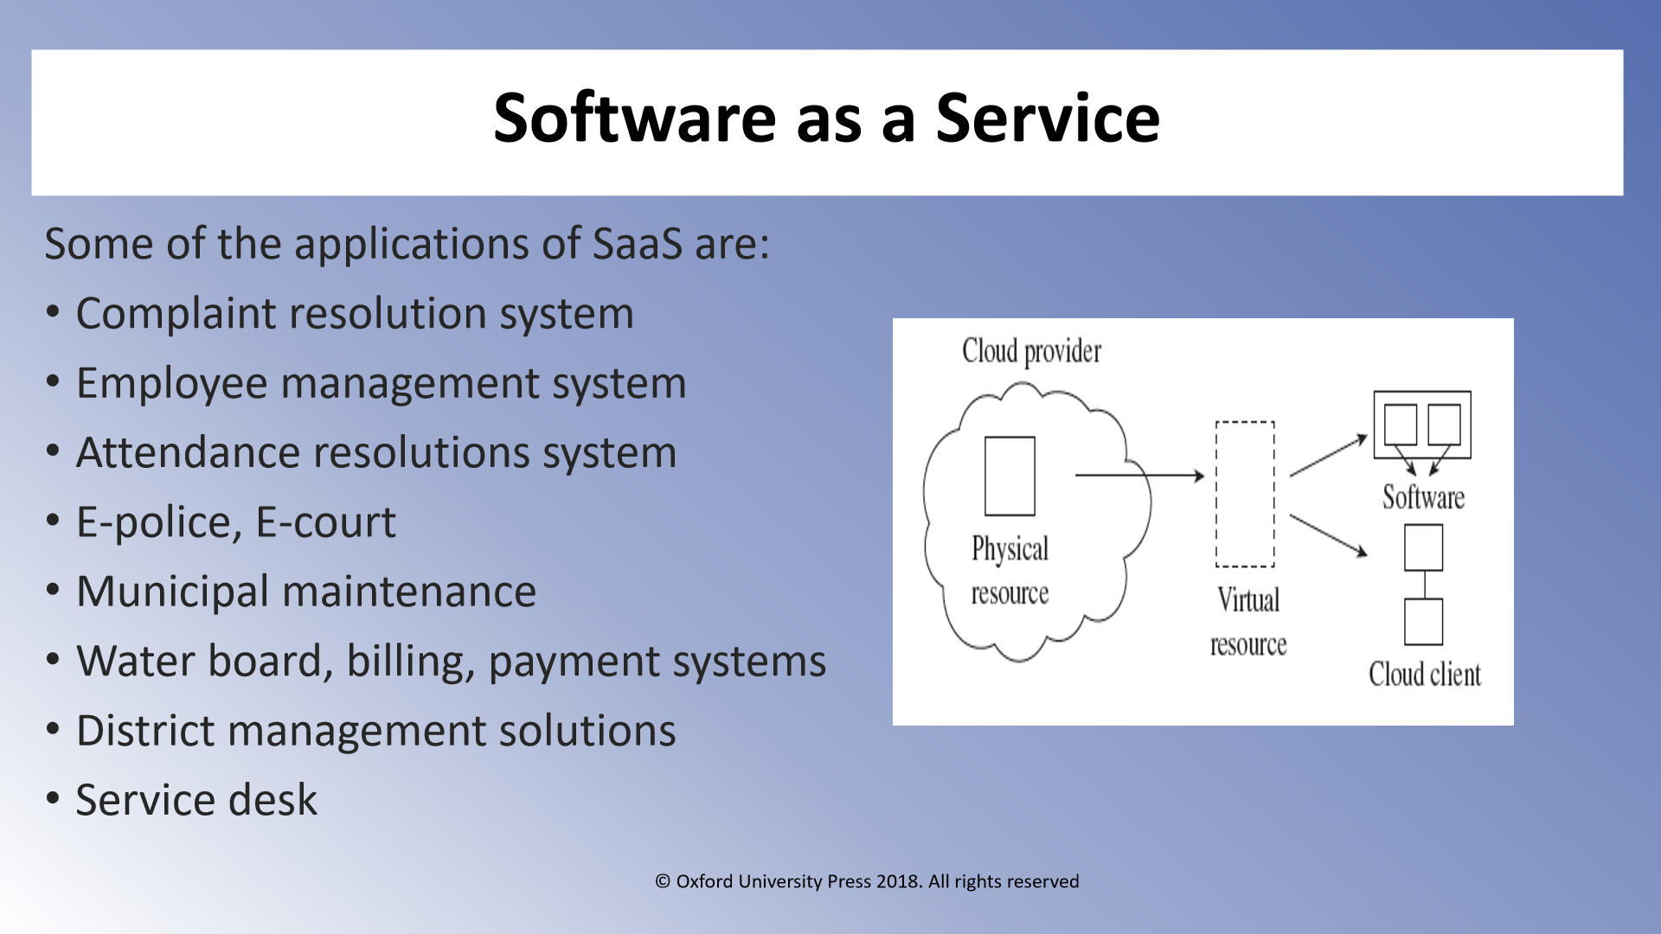

Slide 62
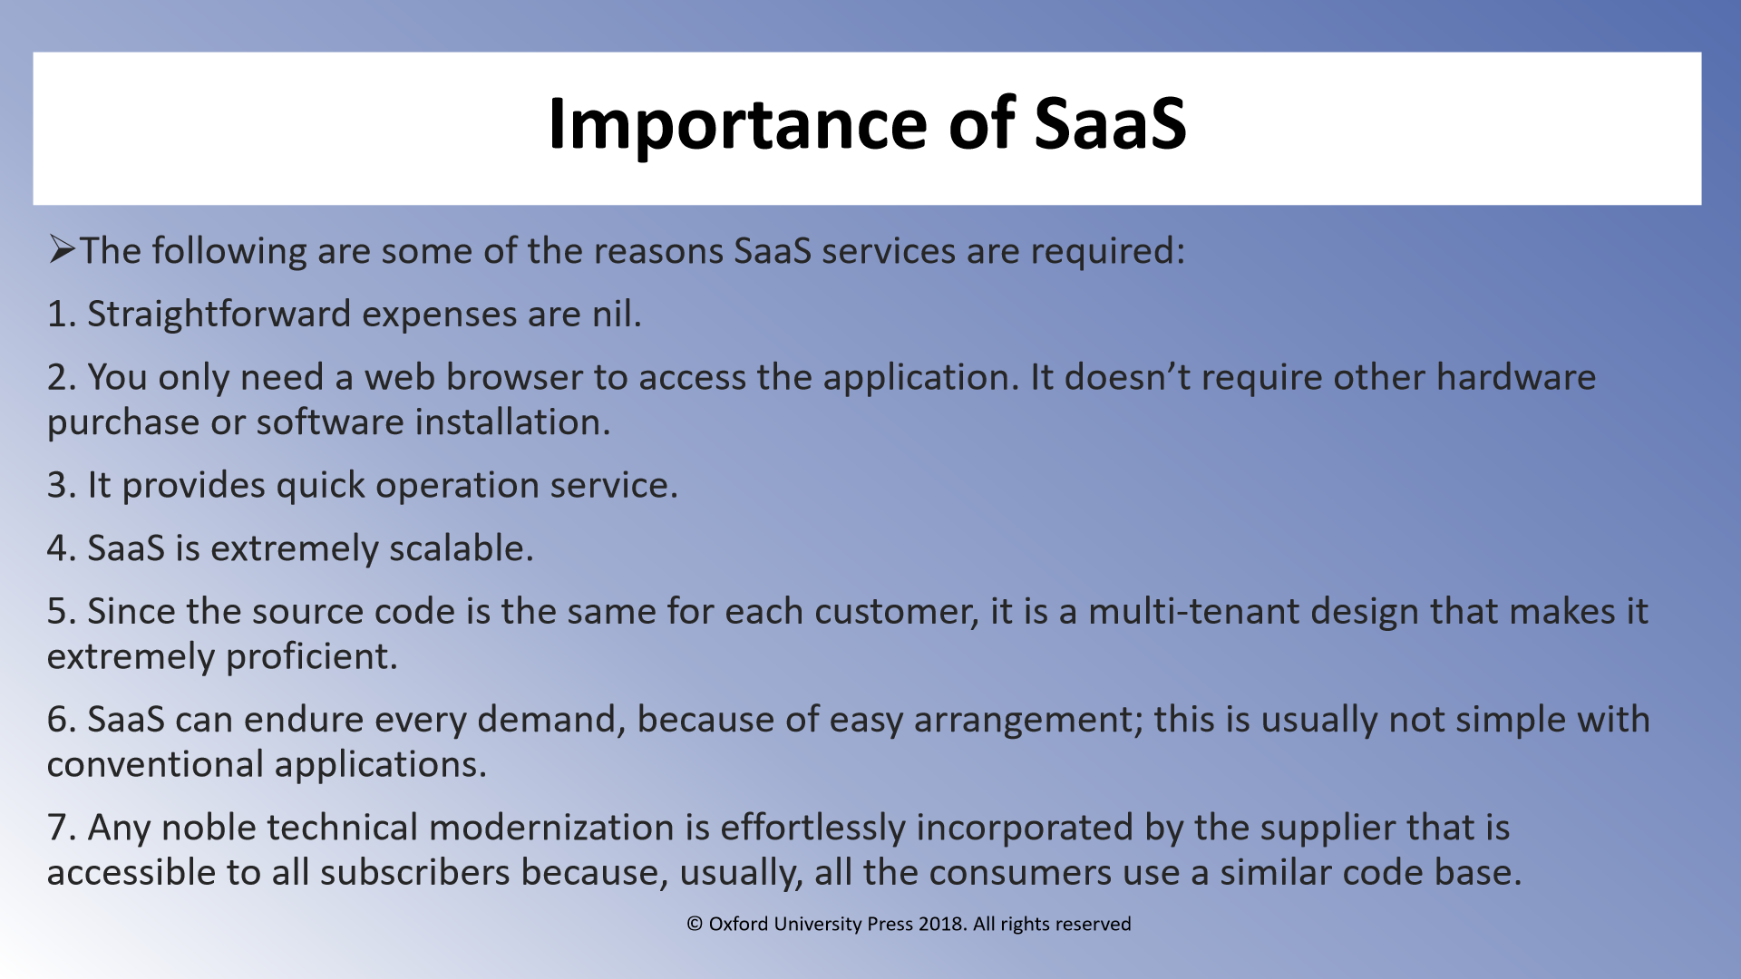

Slide 63
Google App (online office)
Billing and Invoicing System
CRM application
Help Desk application
HR Solutions
Video Processing,
CRM by Salesforce.com.
LotusLive,
Social Networks,
Office Suits
Billing and Collaboration Service
Financial management packages

Slide 64
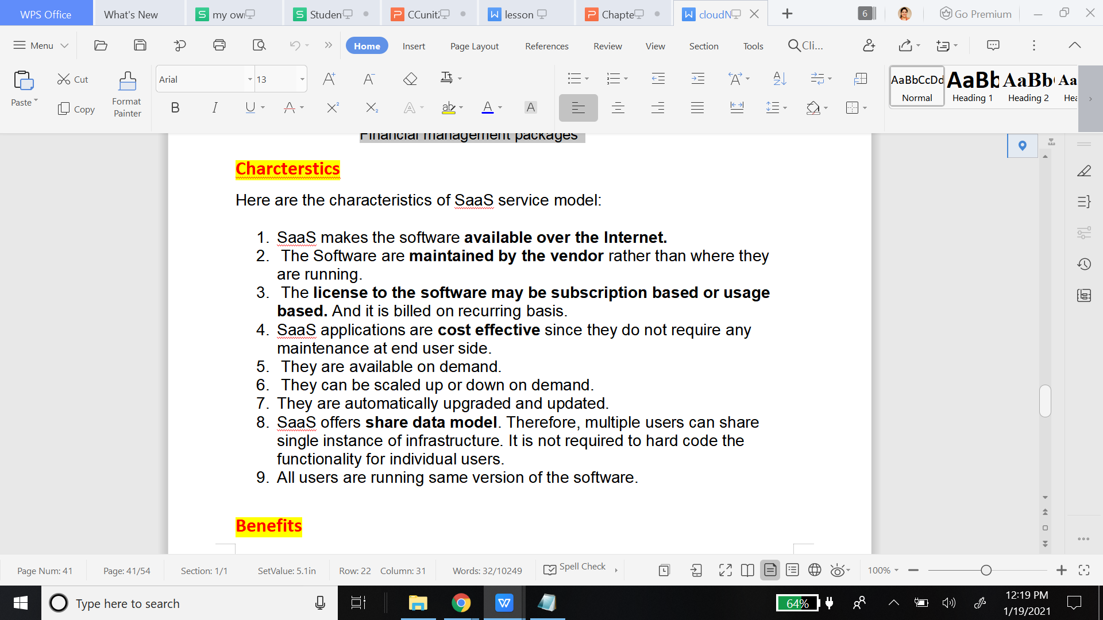
SaaS

Slide 65
SaaS benefits contd..
Reduced Expences : SaaS removes the need for organizations to install and run applications on their own computers or in their own data centers. This eliminates the expense of hardware acquisition, provisioning and maintenance, as well as software licensing, installation and support.
The expense of buying and installing the entire software and IT infrastructure in-house is negated when the software is rented from a third-party service provider.
Flexible payments: Rather than purchasing software to install, or additional hardware to support it, customers subscribe to a SaaS offering. Generally, they pay for this service on a monthly basis using a pay-as-you-go model.
Scalable usage: Cloud services like SaaS offer high vertical scalability, which gives customers the option to access more, or fewer, services or features on-demand.
Trouble Free Upgradation
It is a cumbersome task to upgrade your existing software and hardware to the newer versions.
In many cases, businesses do not have the budget or the IT manpower to upgrade software every subsequent year.
This in turn leaves the software vulnerable to external threats.
On the other hand, when you opt for a SaaS application, this is one burden less for you to bear and removes a significant workload from your in-house IT department. The extra human bandwidth can be used for other tasks such as integration with in-house applications.

Slide 66
SaaS benefits contd
Modest Software Tools
The SaaS application deployment requires a little or no client side software installation which results in the following benefits:
No requirement for complex software packages at client side
Efficient use of Software Licenses
The client can have single license for multiple computers running at different locations which reduces the licensing cost. Also, there is no requirement for license servers because the software runs in the provider's infrastructure.
Centralized Management & Data
The data stored by the cloud provider is centralized. However, the cloud providers may store data in a decentralized manner for sake of redundancy and reliability.
Platform responsibilities managed by provider
All platform responsibilities such as backups, system maintenance, security, hardware refresh, power management, etc., are performed by the cloud provider. The consumer needs not to bother about them.

Slide 67
SaaS disadvantages
Insufficient Data Security
This is one of the top concerns for companies who are looking to opt for a SaaS-based application model. Issues such as identity and access management need to be addressed before trusting any third party service provide with your company's sensitive data. Particularly in the case of accessibility from a mobile device, strict measures need to be taken before any kind of sensitive data is divulged to the service provider.
Connectivity requirement –
since the SaaS model is based on web delivery, if your internet service fails, you will lose access to your software or data
Performance –
SaaS may run at somewhat slower speeds than on-premise client or server applications, so it's worth keeping performance in mind your software isn't hosted on a local machine.
Difficulty with Regulations Compliance
When your business critical data is stored in the service provider's data center, it is difficult to comply with the government's data protection regulations. Your company will need to learn which rules apply to your business, ask the right questions from your service provider, and address any kind of inconsistencies in the process.
Troublesome Software Integration
When working with an external SaaS service provider to host multiple apps, there might be an integration problem with the existing in-house software. The in-house APIs and data structures might not integrate properly with the external software. As a result, you should always perform compatibility checks with all SaaS applications for better results.

Slide 68
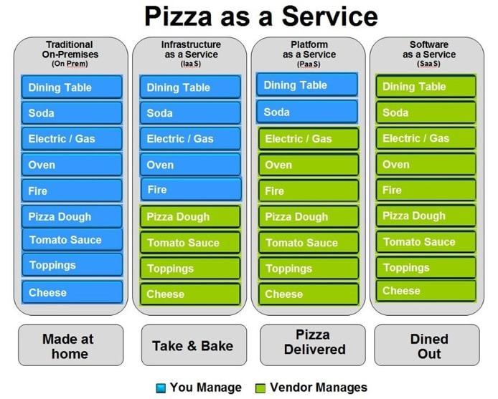

Slide 69
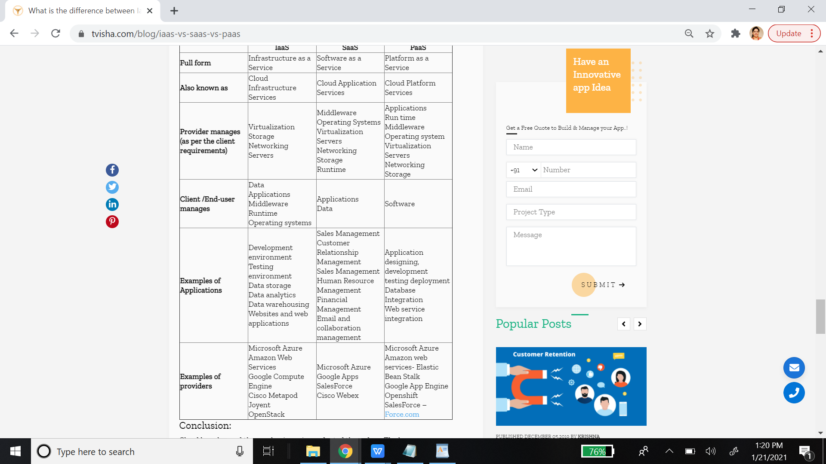

Slide 70
1. Comparison between Cloud, Grid and Mobile Computing.
2. Comparison between deployment models - Private, Public, Hybrid and Community Cloud - pros, cons, example
3. Comparison between service models - IaaS, PaaS, SaaS - pros, cons, example

Slide 71
Also do comparison of their Advantages and Disadvantages

Slide 72
Recovery as a service (RaaS), sometimes referred to as disaster recovery as a service (DRaaS), is a category of cloud computing used for protecting an application or data from a natural or human disaster or service disruption at one location by enabling a full recovery in the cloud.
RaaS differs from cloud-based backup services by protecting data and providing standby computing capacity on demand to facilitate more rapid application recovery.
RaaS capacity is delivered in a cloud-computing model so recovery resources are only paid for when they are used, making it more efficient than a traditional disaster recovery warm site or hot site where the recovery resources must be running at all times

